Slide 1
Digital Portfolio Assessment
Types of e-portfolios and the
tools to create one and why do it..
Presented by:
Linda Morris-Henry
Christina Smith

Slide 2
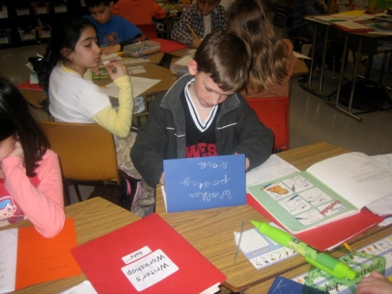
Digital Portfolio/e-Portfolio
.
Digital portfolio or e-Portfolio is a computer documentation of an individuals work to show growth, to showcase current abilities, and/or to evaluate cumulative achievement

Slide 3
Quick Overview
Digital Portfolio
Types of e-Portfolios
Portfolios can serve multi –purpose.
1. Growth Portfolio (support learning)
2. Showcase Portfolio (supports employment)
3. Assessment/Evaluation Portfolio
Survey
How many of you have an organized e-Portfolio?
2. Do you think you need one?

Slide 4
Growth Portfolio
Show growth or change over time
Help develop process skills such as self-evaluation and goal-setting
Identify strengths and weaknesses
Track the development of one more products/performances

Slide 5
Showcase Portfolio
Digital Portfolio
Showcase end-of-year/semester accomplishments
Prepare a sample of best work for employment or college admission
Showcase student perceptions of favorite, best or most important work
Communicate a student's current aptitudes to future teachers

Slide 6
Evaluation Portfolio
To document achievement for grading purposes
To document progress towards standards
To place students appropriately

Slide 7
Theoretical Framework
Notes:
The guru of e-Portfolios Dr. Helen Barrett creates a concept map linking two dynamic processes to promote deeper learning.
The picture below demonstrates why a portfolio promotes a deep learning for all ages. It provides students with the motivation to integrate technology into their learning and demonstrate many skills across the curriculum including technology.

Slide 8
Theoretical Framework
Notes:
The guru of e-Portfolios Dr. Helen Barrett creates a concept map linking two dynamic processes to promote deeper learning.
The picture below demonstrates why a portfolio promotes a deep learning for all ages. It provides students with the motivation to integrate technology into their learning and demonstrate many skills across the curriculum including technology.

Slide 9
Theoretical Framework
Notes:
The guru of e-Portfolios Dr. Helen Barrett creates a concept map linking two dynamic processes to promote deeper learning.
The picture below demonstrates why a portfolio promotes a deep learning for all ages. It provides students with the motivation to integrate technology into their learning and demonstrate many skills across the curriculum including technology.

Slide 10
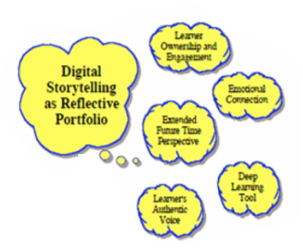
Theoretical Framework
Notes:
The guru of e-Portfolios Dr. Helen Barrett creates a concept map linking two dynamic processes to promote deeper learning.
The picture below demonstrates why a portfolio promotes a deep learning for all ages. It provides students with the motivation to integrate technology into their learning and demonstrate many skills across the curriculum including technology.

Slide 11
Theoretical Framework
Notes:
The guru of e-Portfolios Dr. Helen Barrett creates a concept map linking two dynamic processes to promote deeper learning.
The picture below demonstrates why a portfolio promotes a deep learning for all ages. It provides students with the motivation to integrate technology into their learning and demonstrate many skills across the curriculum including technology.

Slide 12
Theoretical Framework
Constructivist approach to project-based assessment as learning.
Connect to real world activities
Builds upon past, present and future experiences.
Creates new meaning

Slide 13
Examples of how e-Portfolios are being used.
Digital Portfolio

Slide 14
Portfolios support lifelong and life-wide learning.
Source: www.electronicportfolios.com
Notes:
E-Portfolios can be many things for all different reasons. If it is stored on a computer it becomes an e-Portolio.

Slide 15
Elementary Education
http://kids-learn.org
Digital Portfolio
http://kids-learn.org

Slide 16
High School Education
Digital Portfolio
Linda Morris-Henry
Teaches Computer for College and Careers at Deland High School in Volusia County.
In Computer for College and Career (CCC), a requirement of the program is that students are taught how to organize their high school portfolio, which is a graduation requirement.

Slide 17
High School Education
Digital Portfolio
Christina Smith
Teaches Digital Design and business courses at Chiefland High School in Levy County.
http://chieflandhighschoolfl1.web.officelive.com/default.html

Slide 18
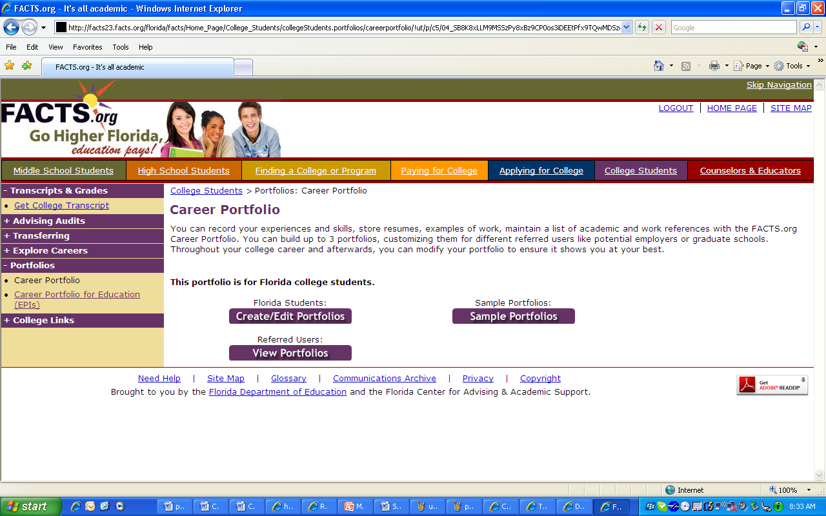
FACTS.org Guidance Education
Digital Portfolio
www.facts.org

Slide 19
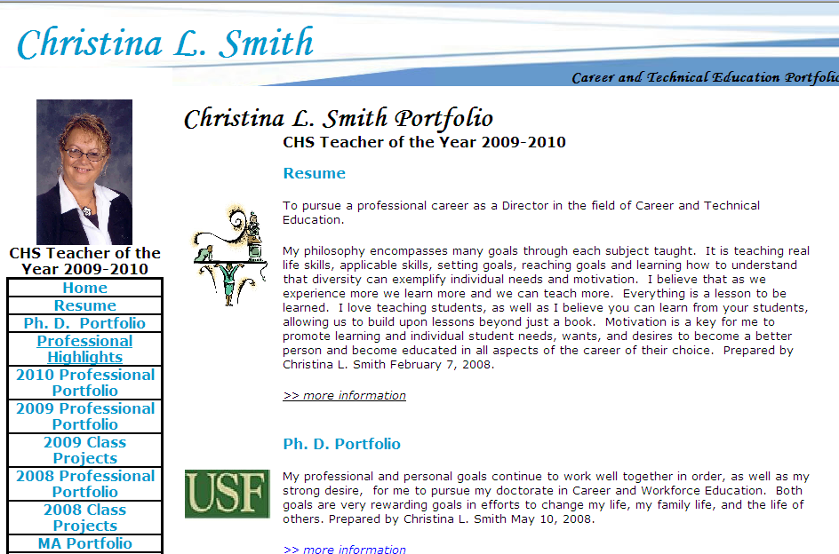
BEYOND HIGH SCHOOL
Digital Portfolio
Christina Smith
http://www.christinalouisesmith.com/Portfolio/Smith.html
Notes:
Professional ePortfolio are a must in pursuing your future career goals as an educator, administrator, or in advanced careers to demonstrate your accomplishments and future goals.

Slide 20
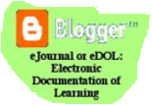
ePortfolio Tools
Digital Portfolio
Examples:
Notes:
Folder on a computer or thumb drive
where all work is saved
Word Documents
PowerPoint
Webpage Software such as FrontPage
Pre-made Templates
The key to creating is where to store, what format you are saving it as and how you link it together.

Slide 21
CONCLUSION
Digital Portfolio Assessment
Presented by: Linda Morris-Henry and Christina Smith
Notes:
“Portfolios provide an excellent vehicle for consideration of process and the development of related skills. So, portfolios are frequently included with other types of authentic assessments because they move away from telling a student's story though test scores and, instead, focus on a meaningful collection of student performance and meaningful reflection and evaluation of that work.” (Jon Mueller, 2008)

Slide 22
What are some e-Portfolio examples that you are familiar with?

Slide 23
References
Arter, J. & Spandel, V. (1992). NCME Instructional Module: Using portfolios of student work in instruction and assessment. Educational Measurement: Issues and Practice, 11(1), 36-44. Retrieved September 27, 2010 from http://www.ncme.org/pubs/items/18.pdf
Barrett, Helen C., Ph.D (2004), “Picture of Electronic Portfolios”,
http://electronicportfolios.com/digistory/ePortfolioStory.pdf Retrieved 14 September 2010
Barrett, Helen C., Ph.D. (2008), “Categories of E-Portfolio Tools”,
http://electronicportfolios.com/categories.html , Retrieved 14 September 2008
Barrett, H. (2006) Using Electronic Portfolios for Classroom Assessment. Connected
Newsletter 13(2) _ 4-6. Retrieved 27 September 2010 from,
http://electronicportfolios.com/portfolios/ConnectedNewsletter-final.pdf
Baeten, M., et. al., (2008). Students' approaches to learning and assessment
preferences in a portfolio-based learning environment [Part of a special issue entitled Effects of constructivist learning environments]. Instructional Science v. 36 ( 5/6) (September 2008) p. 359-74
California Department of Education. (1997). Middle school and high school transitional portfolios and guides. Retrieved 14 September 2010 from, http://www.dcn-cde.ca.gov/portfolios.htm.
Coalition of Essential Schools. (2002), Resources. Retrieved 14 September 2010 from,
http://www.essentialschools.org/pub/ces_docs/resources/dp/cet.html

Slide 24
References (con’t)
FACTS.org (2008), “Career Portfolios”, http://facts23.facts.org/portfolio/index.jsp?pageId=060501 Retrieved 14 September 2010.
ISTE. (2008). National educational technology standards and performance indicators for teachers. Retrieved 20 September 2010 from, http://www.iste.org/Content/NavigationMenu/NETS/ForTeachers/2008Standards/NETS_T_Standards_Final.pdf
Franklin, Teresa (2005). Seeking an electronic portfolio solution: A case study. Retrieved 27 September 2010 from, http://www.iste.org/Content/NavigationMenu/Research/NECC_Research_Paper_Archives/NECC_2005/Franklin-Teresa-NECC05.pdf
Lankes, A. (1995). Electronic Portfolios: A New Idea in Assessment. Eric. ED390377
Retrieved September 27, 2010 from http://www.ipm.edu.mo/update/intranet/dap/tt_hedu_evaluate/student/01.pdf

Slide 25
References
Lester, J. & Perry, N. (1995). Assessing career development with portfolios. ERIC Digest Identifier: ED391110 . Retrieved September 27, 2010 from http://www.ericdigests.org/1996-3/development.htm
Lombardi, J. To portfolio or not to portfolio: Helpful or hyped?. College Teaching v. 56 no. 1 (Winter 2008) p. 7-10.
Mueller, Jon. (2008). Authentic assessment toolbox. Retrieved 20 September 2010 from,
http://jonathan.mueller.faculty.noctrl.edu/toolbox/portfolios.htm
Niguidula, David. (2001). A richer picture of student performance. Retrieved 14 September 2010 from, http://www.essentialschools.org/pub/ces_docs/resources/dp/cet.html
Richer Picture. (2008). A digital picture of student achievement. Retrieved 23 September 23, 2010 from, http://www.richerpicture.com/samples.php#elementary
Ring, G., Foti, S. (2003). Addressing standards at the program level with electronic portfolios. Tech Trends. 47(2) 28-33.

