Slide 1
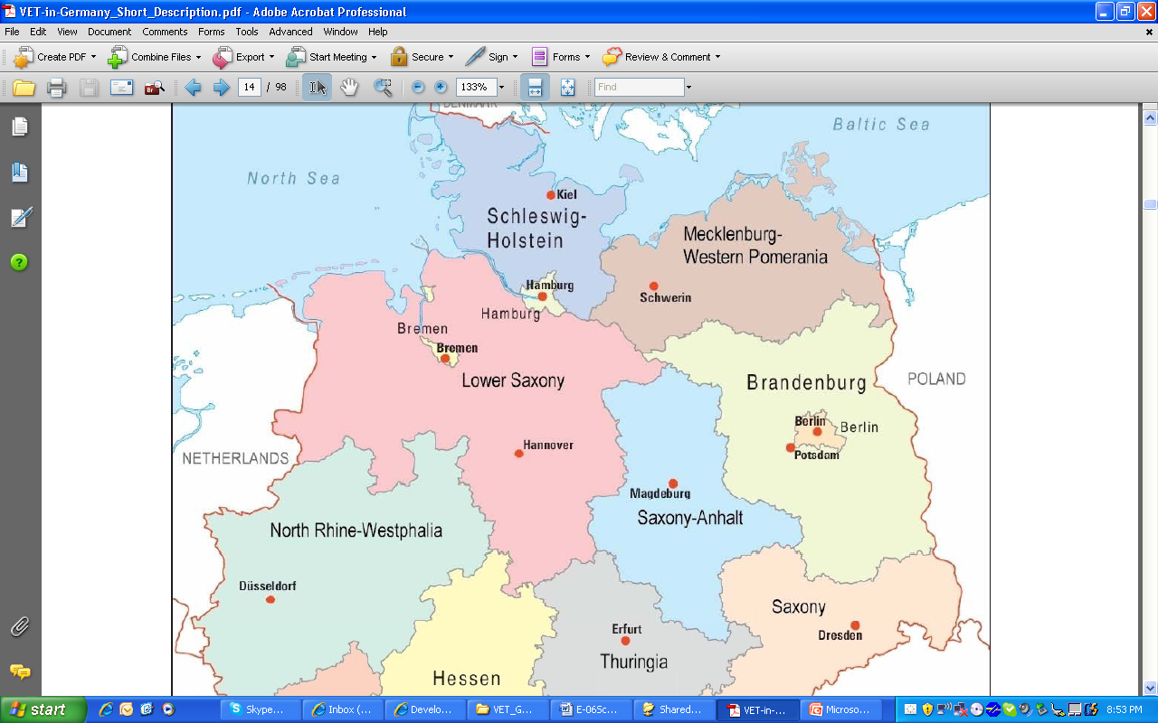
The German System of Career & Workforce Education
Christina Smith
August 19, 2010

Slide 2
Germany’s Educational System
After the middle school students are tested to see what school they will attend.
The dual system is far and away the largest field of education at upper secondary level, with approximately
53 % of an age cohort training for a recognised training occupation.
Berufsschule (Dual System)
Dual System of vocational education

Slide 3
The Deutsch Model
Fachschule or University
Berufsschule (Dual System) or Gymnasiale Oberstufe
Hauptschule, Realschule, Gymnasium (Secondary Tracks)
Grundschule (Primary to age 10)
Kindergarten

Slide 4
The Deutsch Model
With a focus on science, language, and math, students completing Gymnasium matriculate to the university setting.
Students can earn a bachelor’s masters or PhD degrees.

Slide 5
The Deutsch Model
Students completing Realschule enter the full-time “vocational” school for three years. There is no OJT.
There are 22 vocational schools in Bremen.
Some of these students may articulate to the university setting.

Slide 6
The Deutsch Model
Students completing Hauptschule will enter the “dual education system” at age 16 for up to three and a half years of work study.
Sixty-five percent of students take this route to successful careers.
Dual education is a combination of work and education.

Slide 7
Germany’s Vocational Belief
Learning on the job is a traditional component of the education system.
All vocational training is aimed at imparting comprehensive professional competence in the occupation.
Vocational training in Germany is guided not only by the requirements of the labour market, but also by the need for individuals to acquire skills, knowledge and competences that enable them successfully to prove themselves on the labour market.
Training programmes are designed on the principle that they should be as broad as possible and as specific as necessary.

Slide 8
Germany
Is made up of Landers or states that regulate education at local levels similar to the United States.
Within the Landers, the local Chamber of Commerce which is similar to the formation of business partners within the local communities in the United States.
Large business partners such as Mercedes, Volkswagon, Airbus, Kraft Foods, and Beck’s Beer make up the over 40000 members.
Notes:
http://www.bibb.de/en/

Slide 9
Chambers of Commerce
.
Local committees make up regionally committees that:
They are responsible for advising companies, registering trainees, certifying trainers’ specialist aptitude, accepting examinations and conducting social dialogue at regional level.
They are responsible for important tasks in the implementation and supervision of pre-vocational training and of vocational training, further training and retraining.
Local business members of industry create industry certification tests to be implemented with their communities.
They assure quality of in-company trainings and responsible in monitoring the Regulation on Trainer Aptitude and the occupation’s relevant training directive.
The Chambers of Industry and Commerce, Craft Chambers, the The Federal Institute of Vocational Education and Training (BIBB) must draw up a description of each qualification building block, which must include, among other things, the designation of the building block, the training occupation on which it is based, the qualification aimed at, the activities to be provided for this purpose, with reference to the skills and knowledge contained in the framework training plan of the relevant training directive, the duration of provision and the nature of the performance observed (qualification picture).
They create occupational profiles and currently they have 340.
They have a big voice in education

Slide 10
Occupational Profiles
Approximately 340 occupational profiles (compared to about 10,000 in the United States.)
50.6% - Industry and Commerce
35% - Skilled Trades
8.6% - Liberal Professions
2.7% - Civil Service
2.3% - Agriculture
0.8% - Other

Slide 11
German Apprenticeships
Investments by Government and Employment Organizations
Education is provided at no cost
Companies cover nearly 68 percent of the costs associated with running the dual system
Incredible involvement in the process by Chambers of Commerce

Slide 12
German Apprenticeships
Students must score high enough on their final exam in school to be accepted into apprenticeships.
Students sign contracts at age 16, knowing they have a future.
Students work for three years in apprenticeships and rotate days working and instructional learning in an educational setting.
The first year they do not do any skilled work on training in training labs.
Vocational School curricula is made up of 2/3 vocationally oriented course material and ½ integrating academics with CTE. They do not teach Shakespeare per Dr. Glesser.
We toured Airbus for an indepth look at apprenticeships, safety was a key issue in the work performed.

Slide 13
German Apprenticeships
Benefits for Apprentices
Gaining good employment
Obtaining recognized industry training
Develop a level of company loyalty
Increase their sense of pride in craftsmanship

Slide 14
German Apprenticeships
Benefits for Employers
Supporting the local workforce
Building a trained workforce
Building brand/company loyalty
Creating a culture of workforce pride

Slide 15
Lessons Learned Abroad
Germany’s dual education system (apprenticeship program) is the “gold standard of excellence” in helping to train and develop young workers.
A major factor is the collaborative investment made by all key stakeholders and fostered by a several hundred year old culture of work.

Slide 16
Lessons Learned Abroad
Project based learning based on actual industries operations.

Slide 17
FYI
There is no minimum wage the wage is set by the unions and everyone gets paid the same.
Education cost nothing. One primary teacher cost her $500.00
They only work 36 hours a week and have two vacations a year.
They even pay for you to stay home the first year of your child’s life
The PH D program in Germany consists of four years of writing your research paper.
All students learn English in the first grade.
Everyone does three years apprenticeships whether a front desk clerk, nurse or teacher.
Germany doesn’t differentiate but are starting to implement the process, although testing and placing is based on their ability anyway.
They just started a new school for drop outs this year, it is to do teach those real life skills such as home economics, Cooking, balancing check books.
School s work in teams and are on several teams in Gymnasiums.

Slide 18
Implications for Broader Impacts
Career and Technical Education is at a significant point in time of importance.
Are business and industry interested in investing in their future workforce or do they simply want to get one more boxes on the truck today?

Slide 20
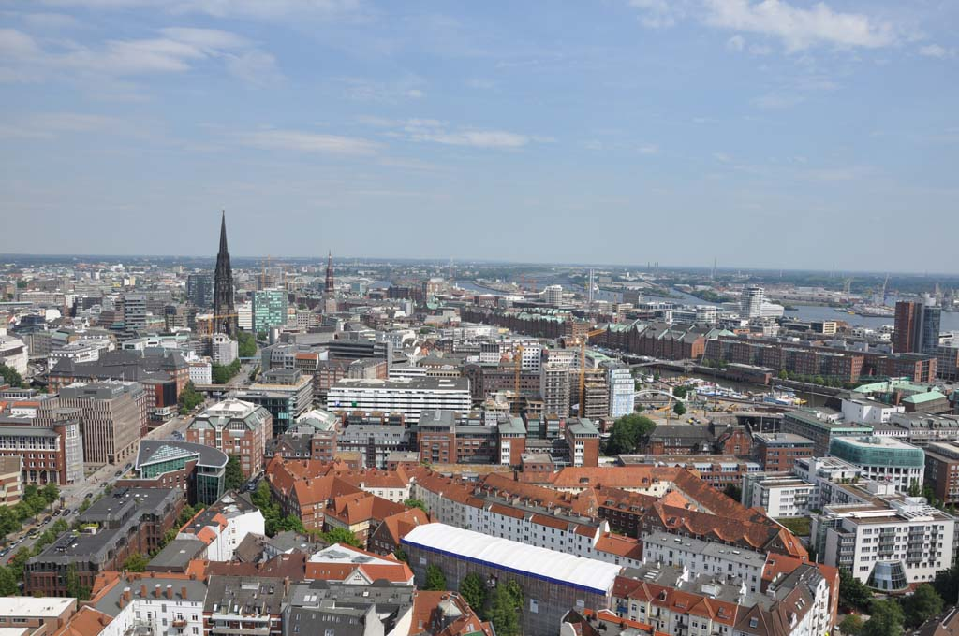

Slide 21
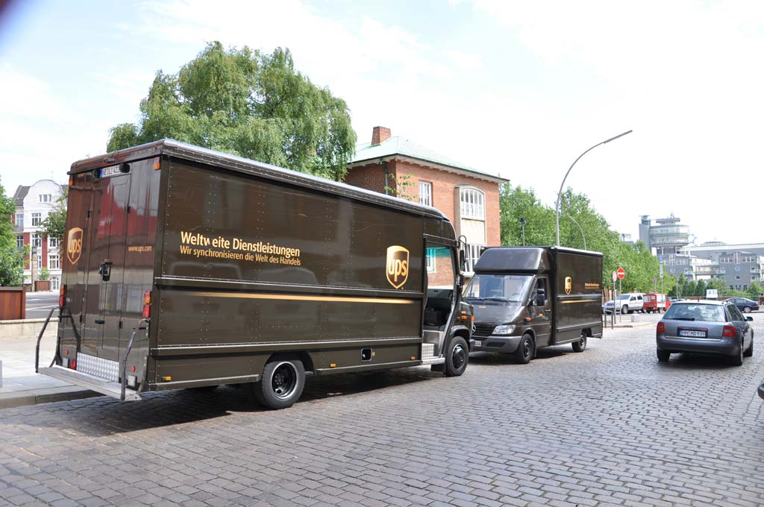

Slide 23
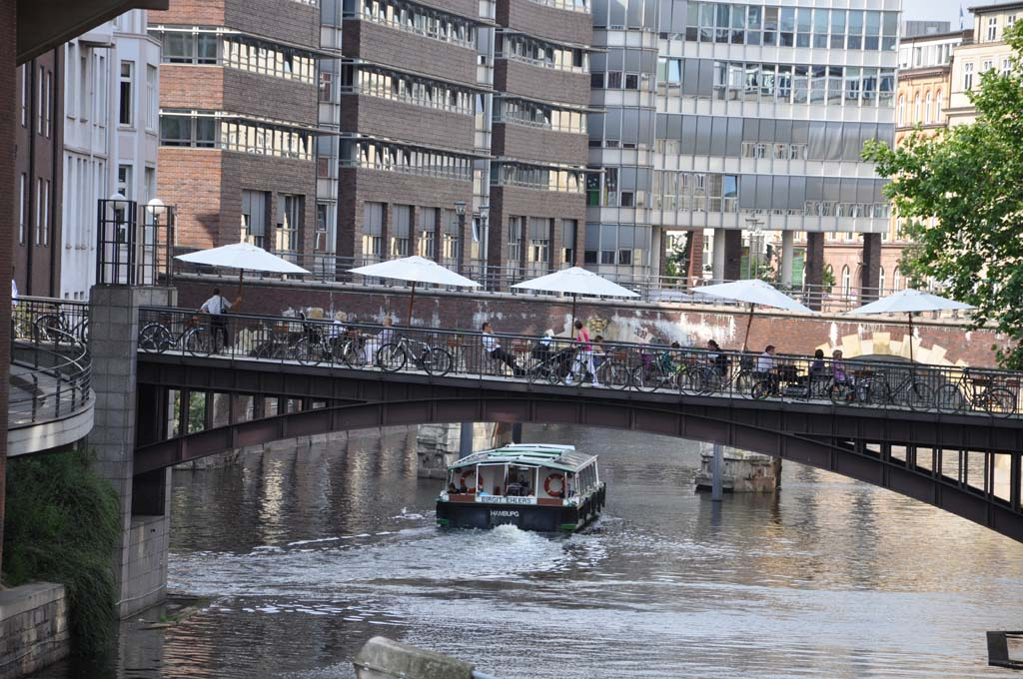

Slide 27
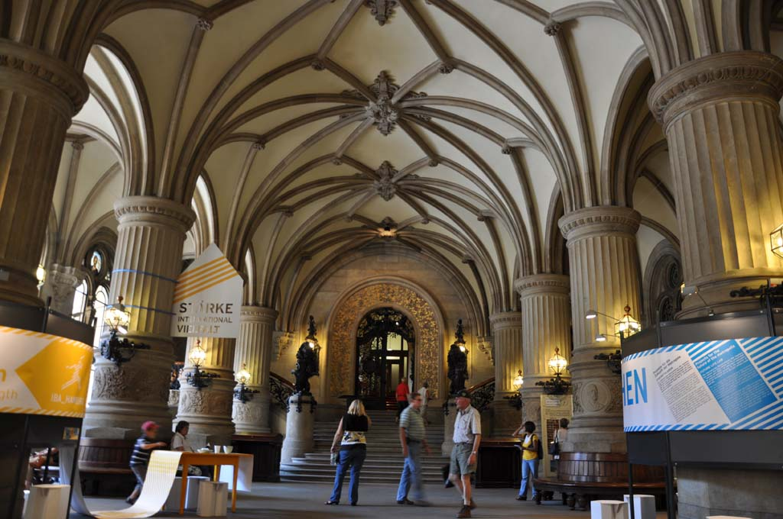

Slide 28
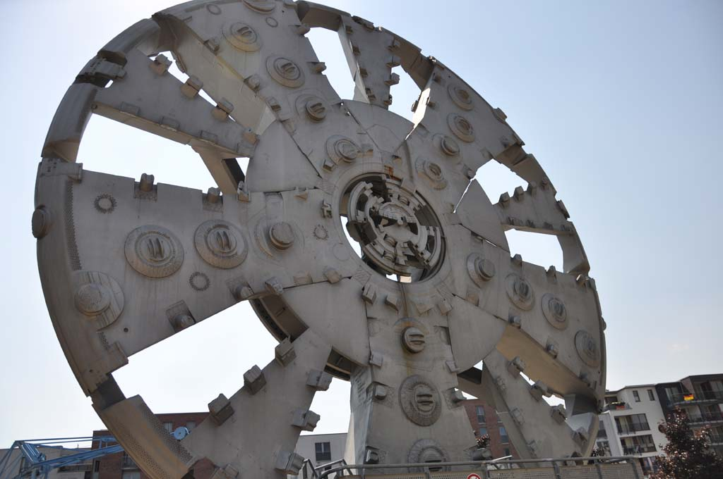

Slide 29
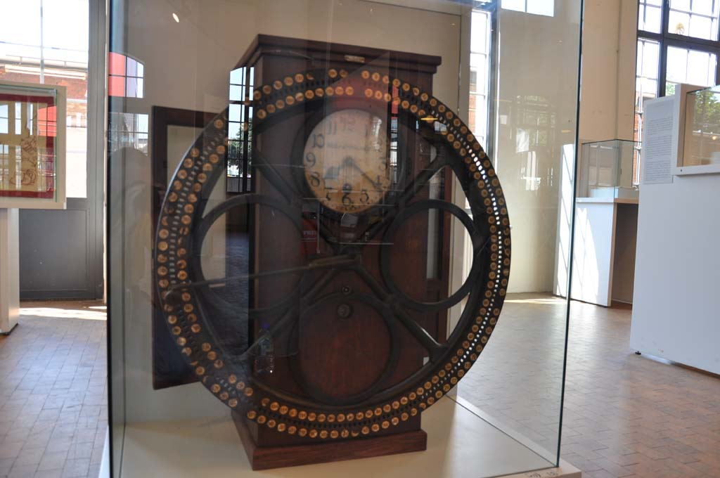

Slide 30
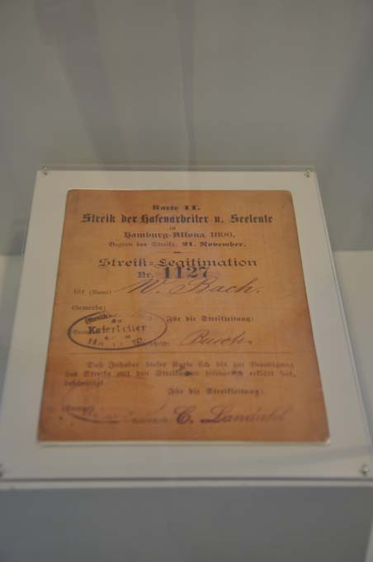
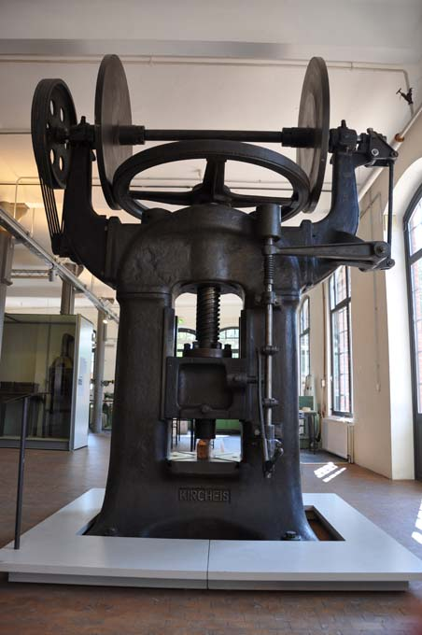

Slide 31
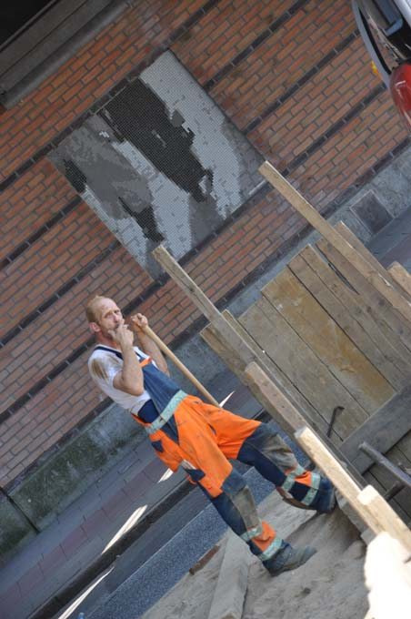
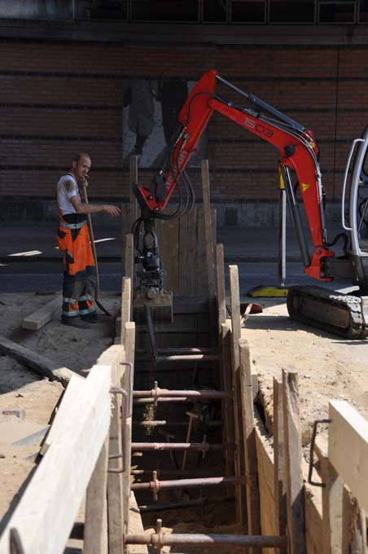

Slide 32
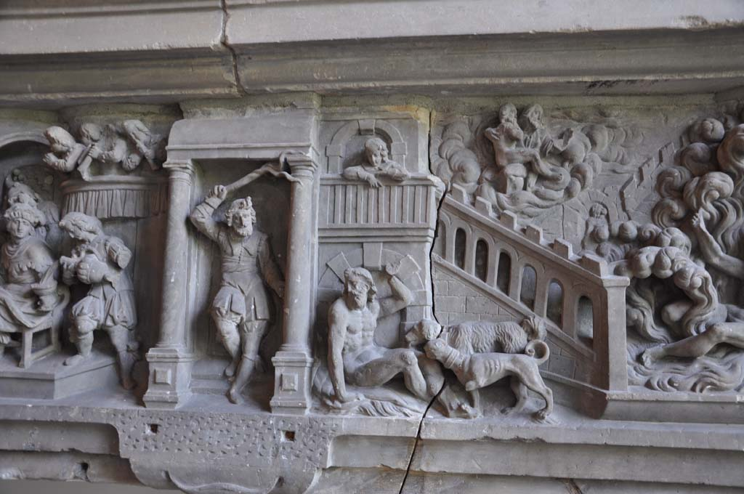

Slide 33
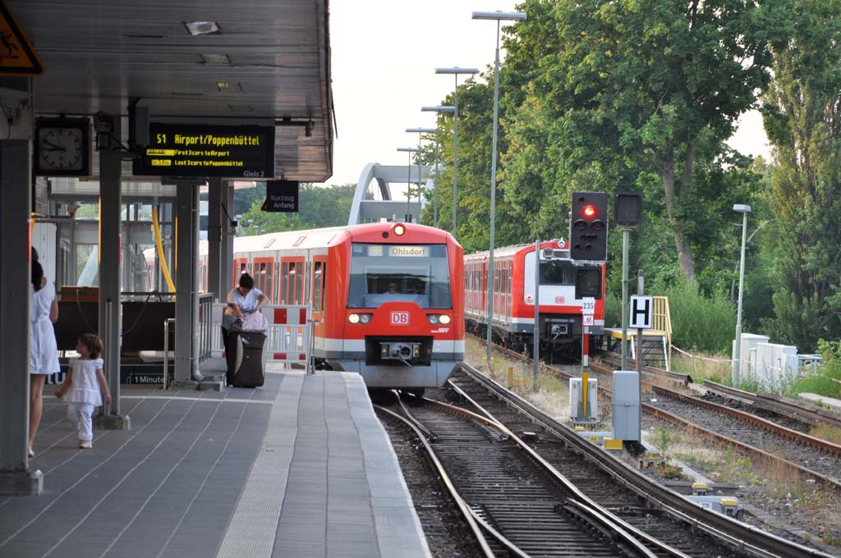

Slide 34
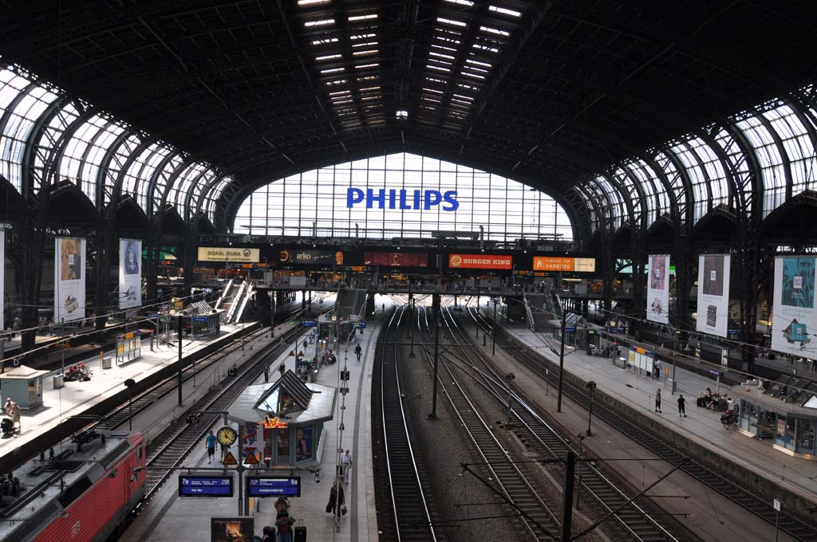

Slide 35
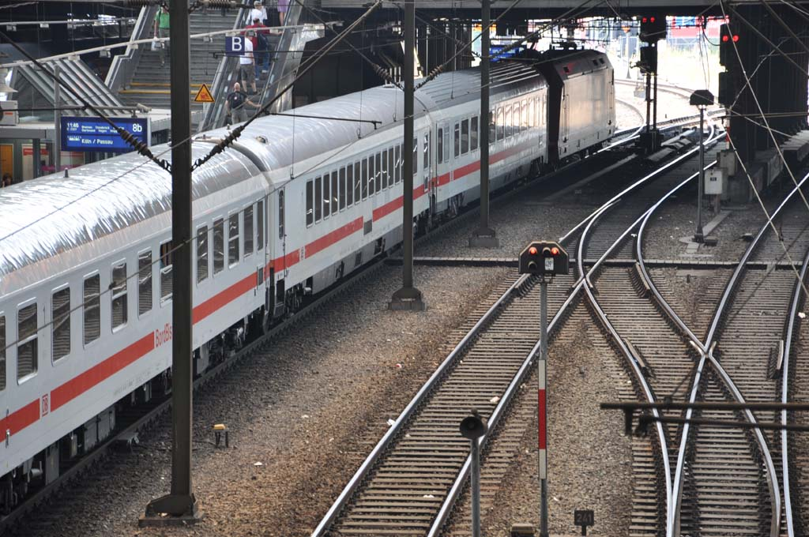

Slide 36
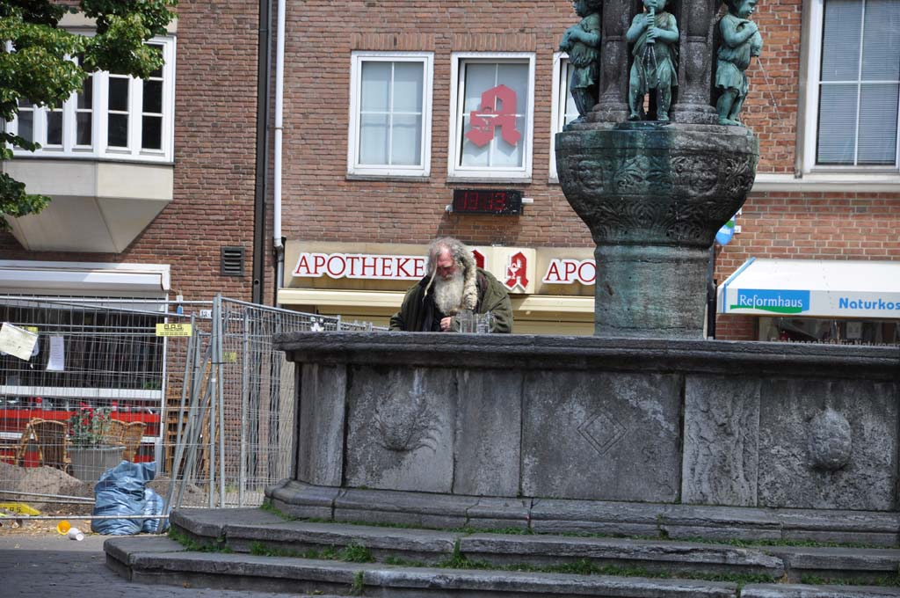

Slide 38
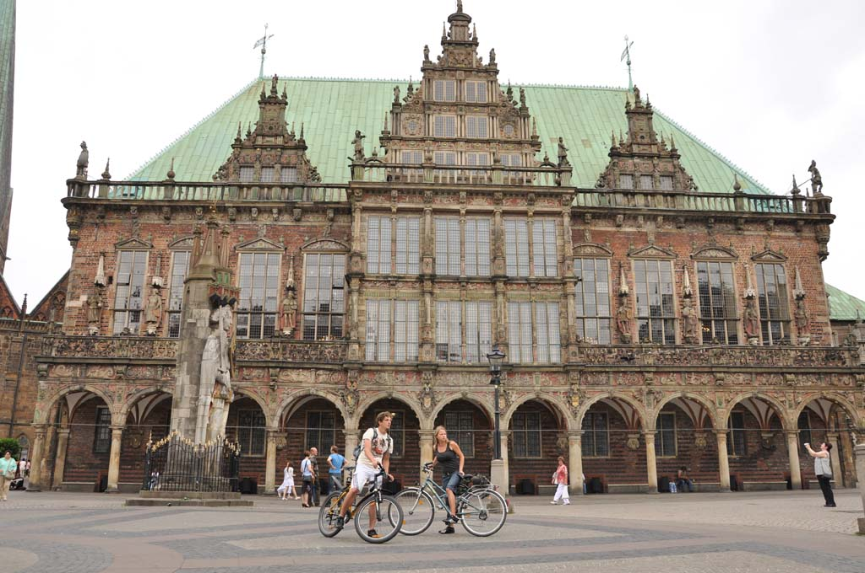

Slide 41
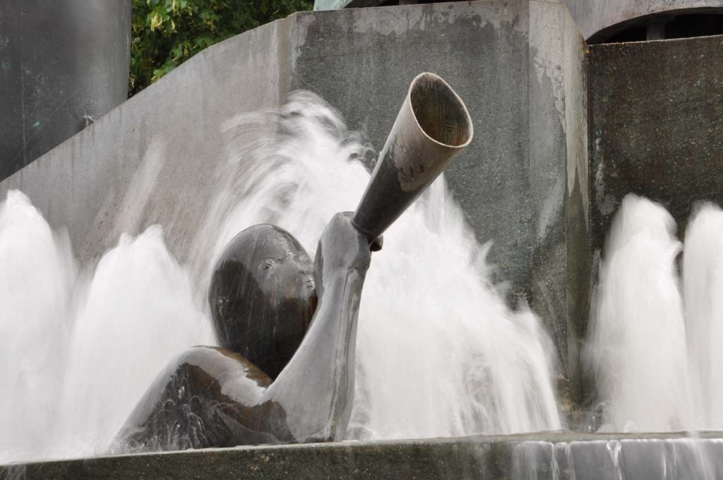

Slide 42
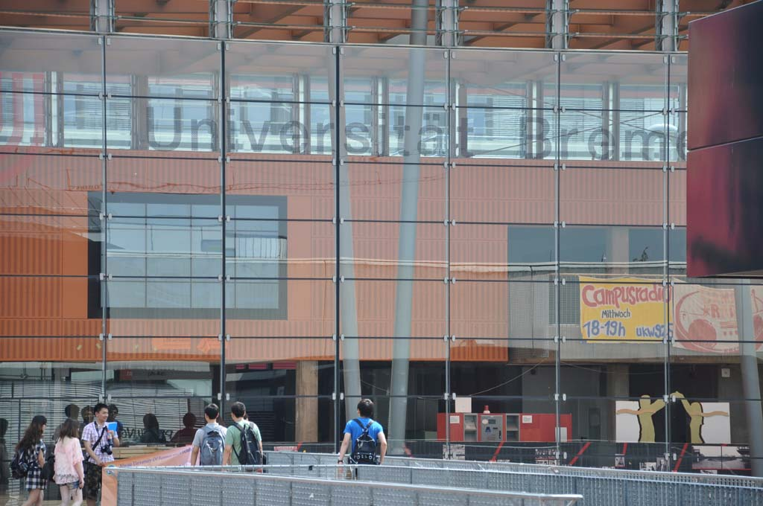

Slide 43
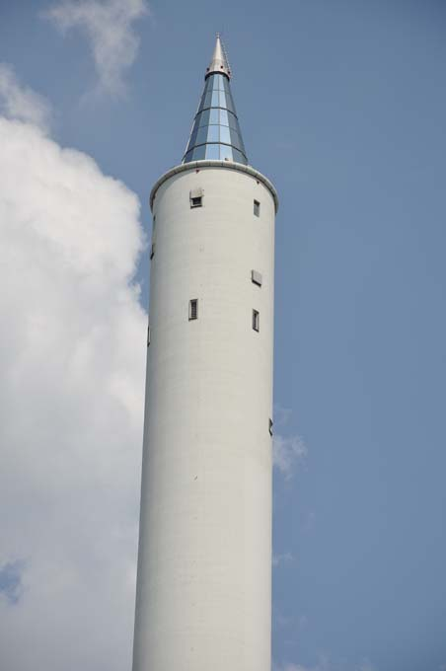
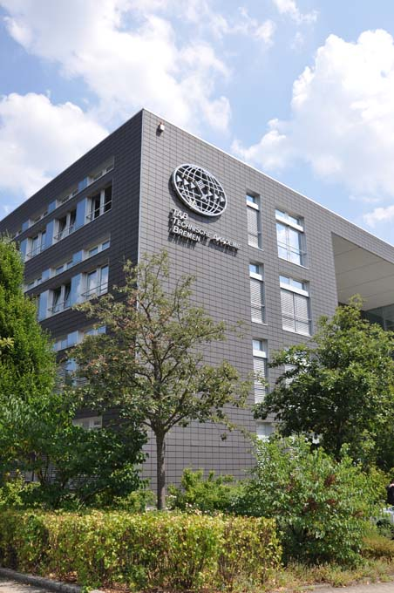

Slide 44
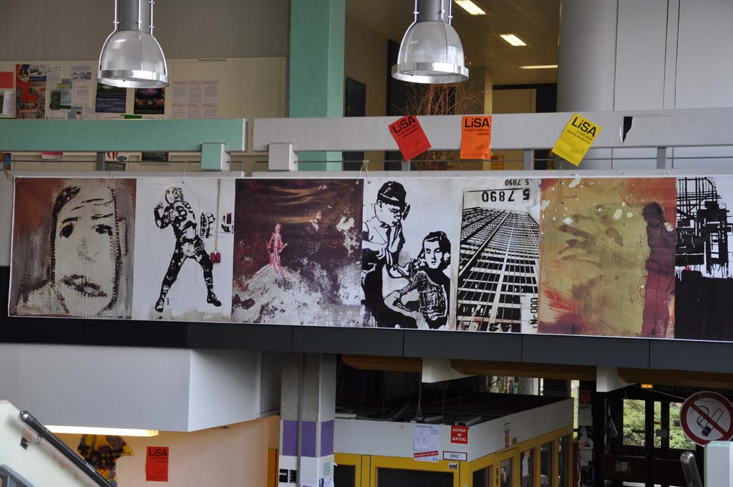

Slide 45
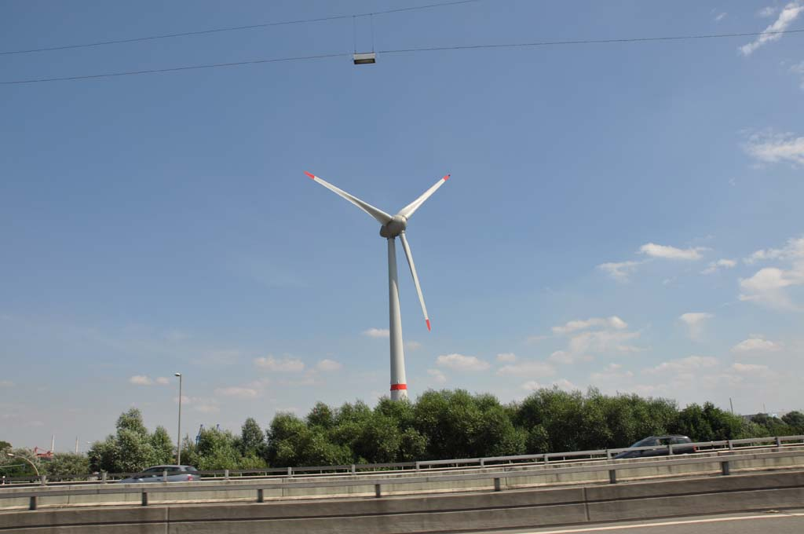

Slide 47
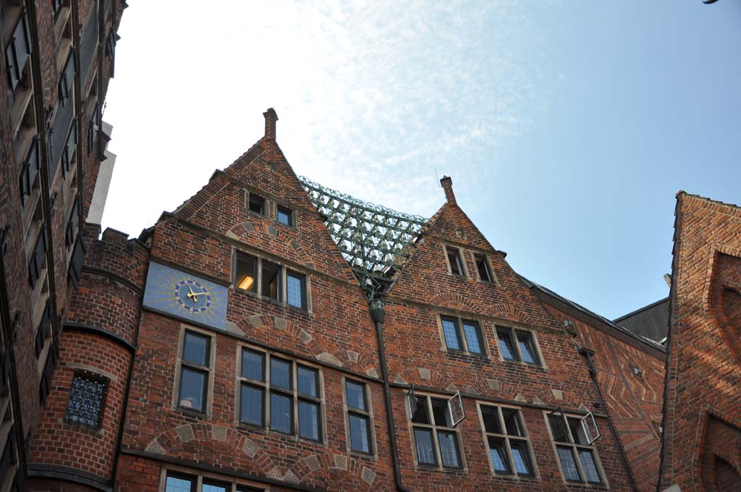

Slide 48
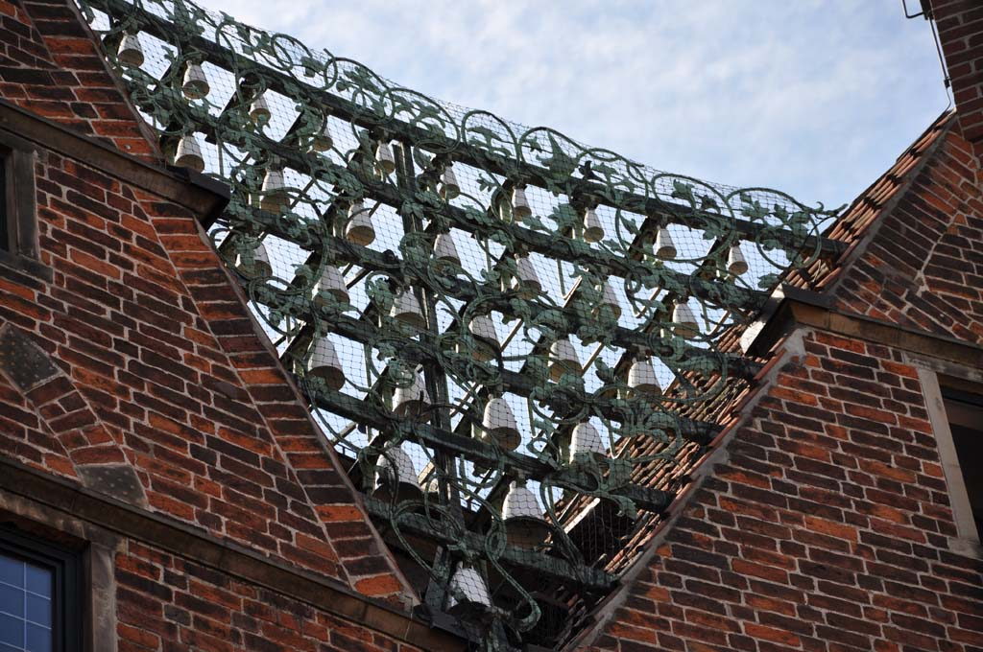

Slide 50
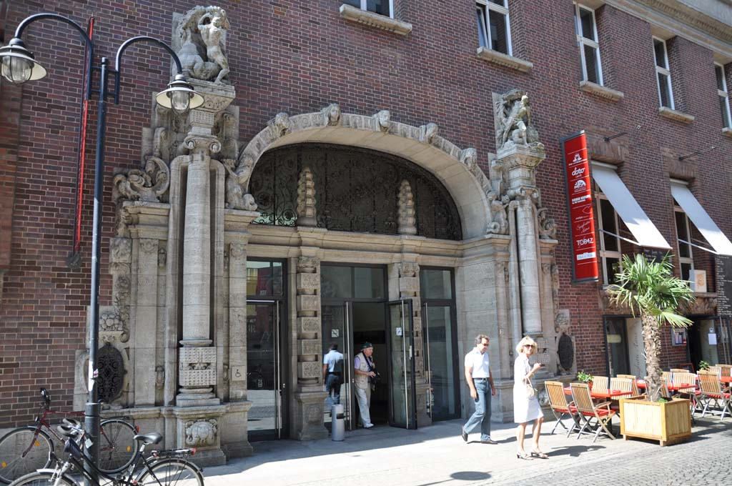

Slide 52
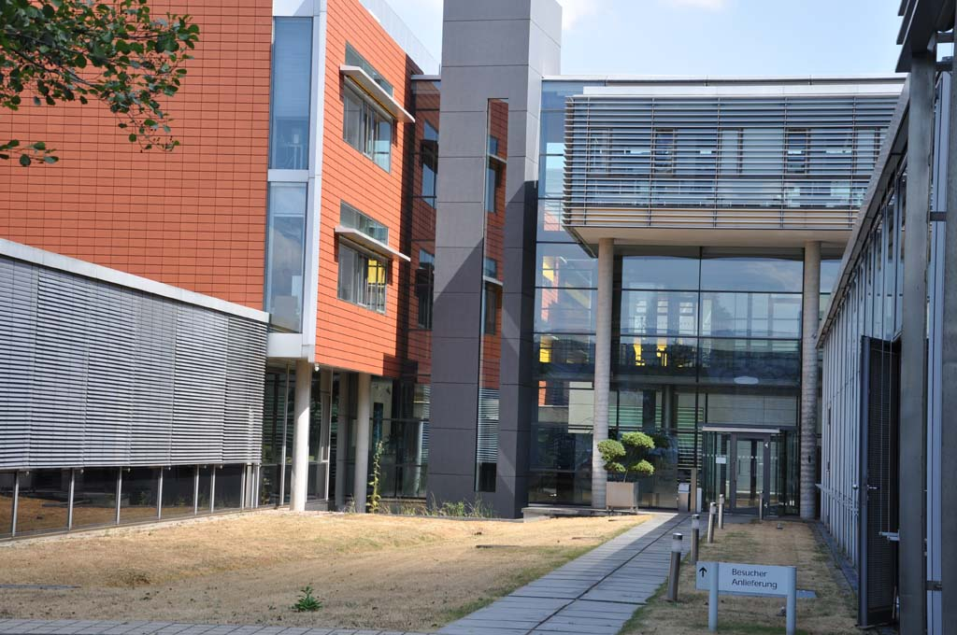

Slide 55
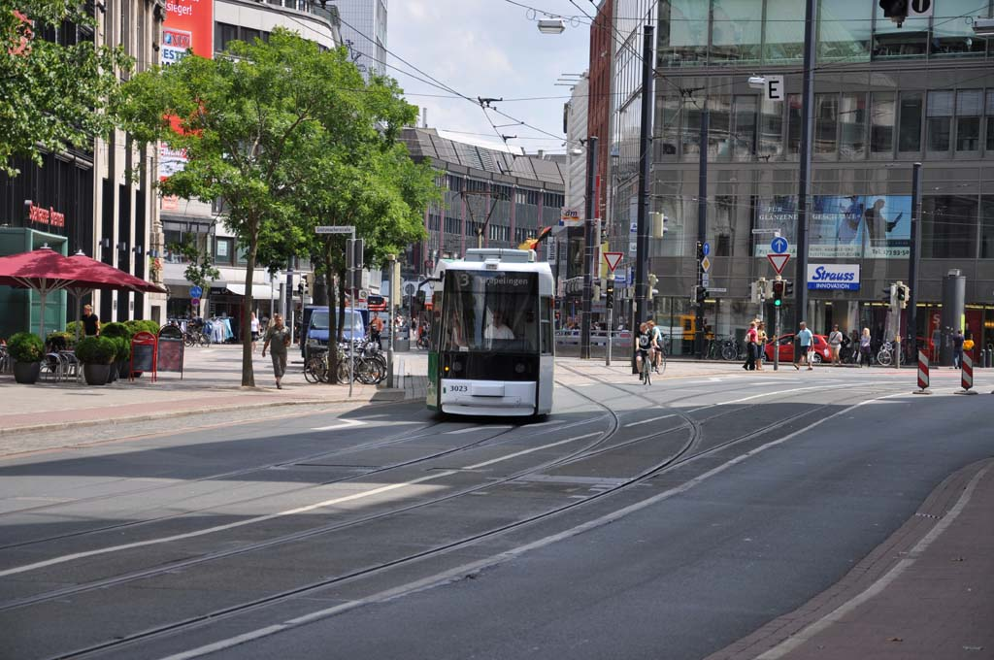

Slide 56
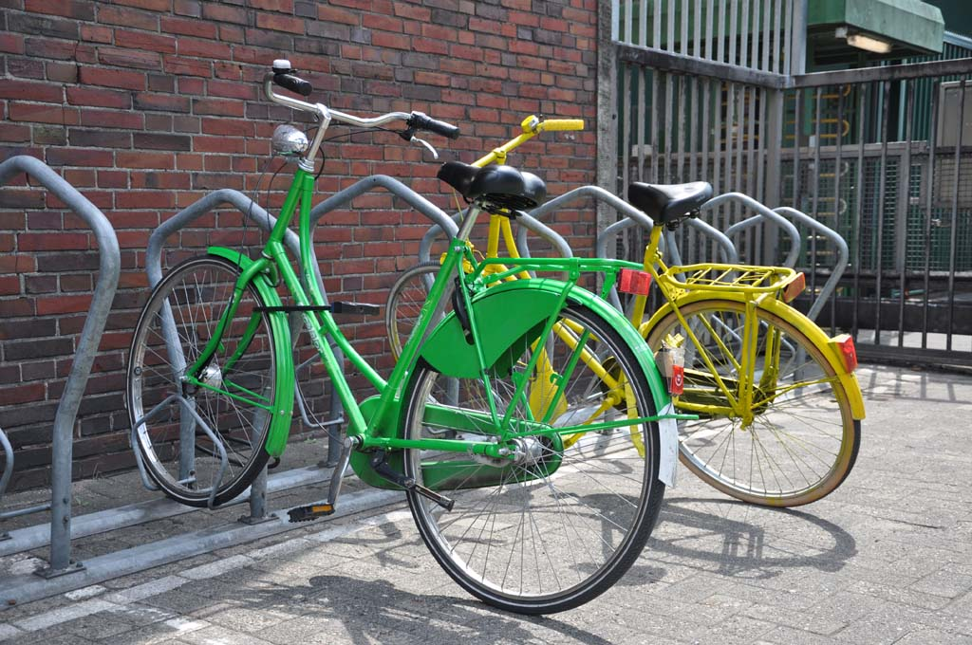

Slide 57
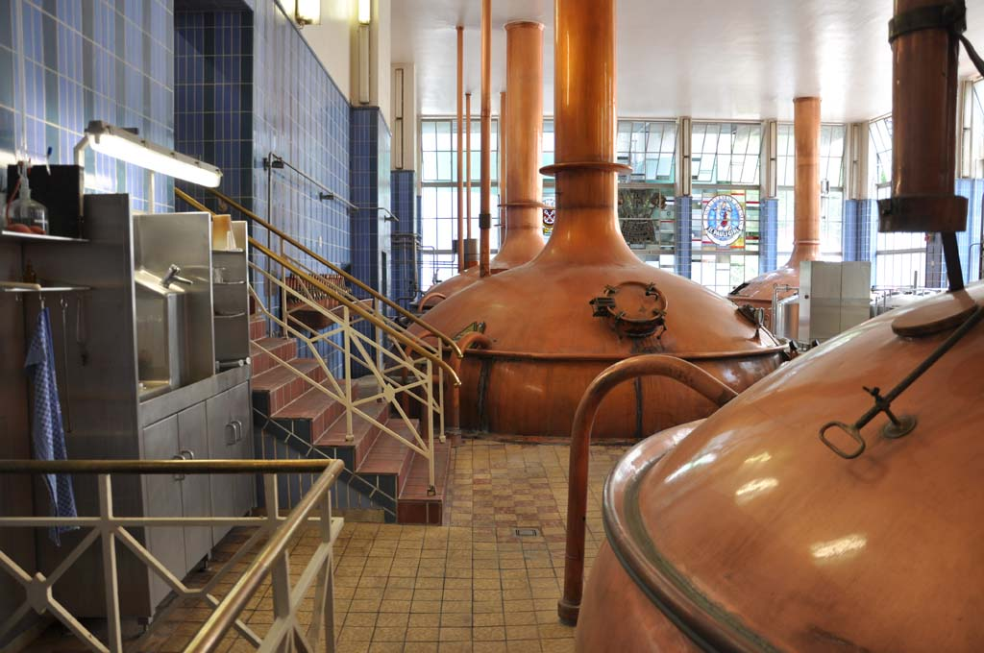

Slide 58
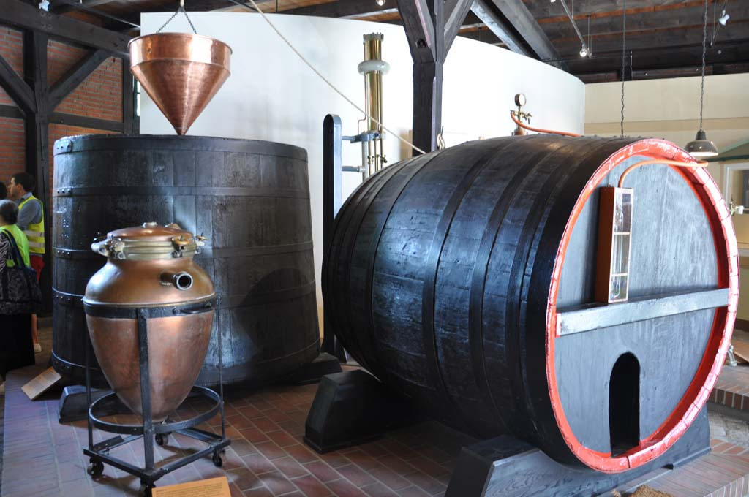

Slide 59
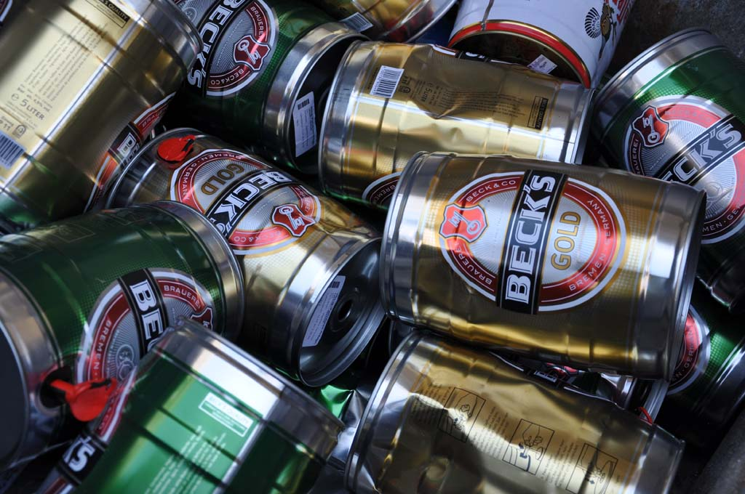

Slide 60
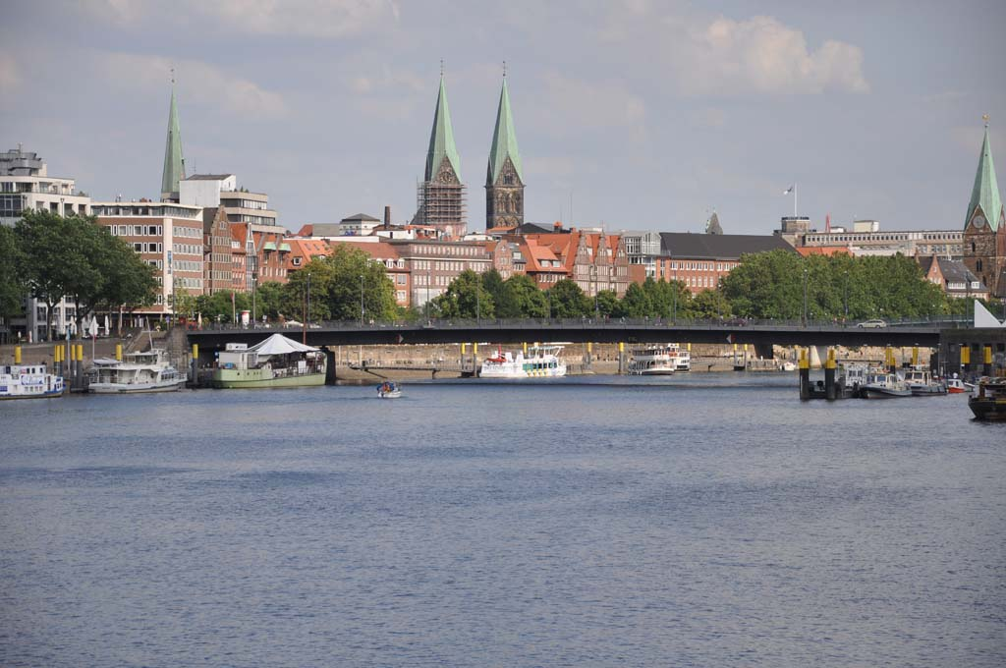

Slide 62
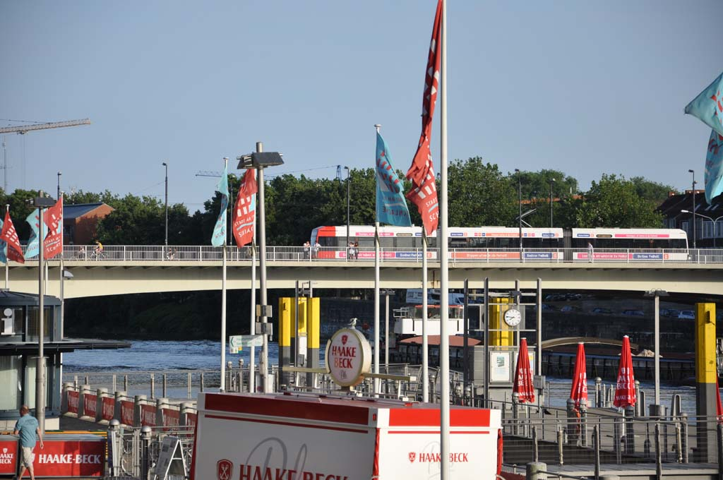

Slide 63
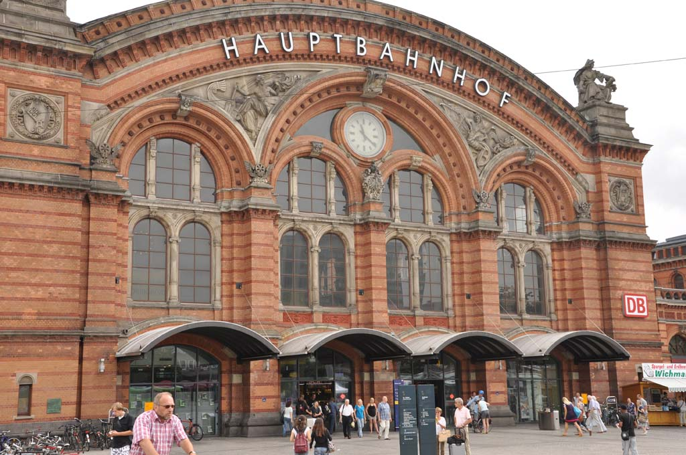

Slide 65
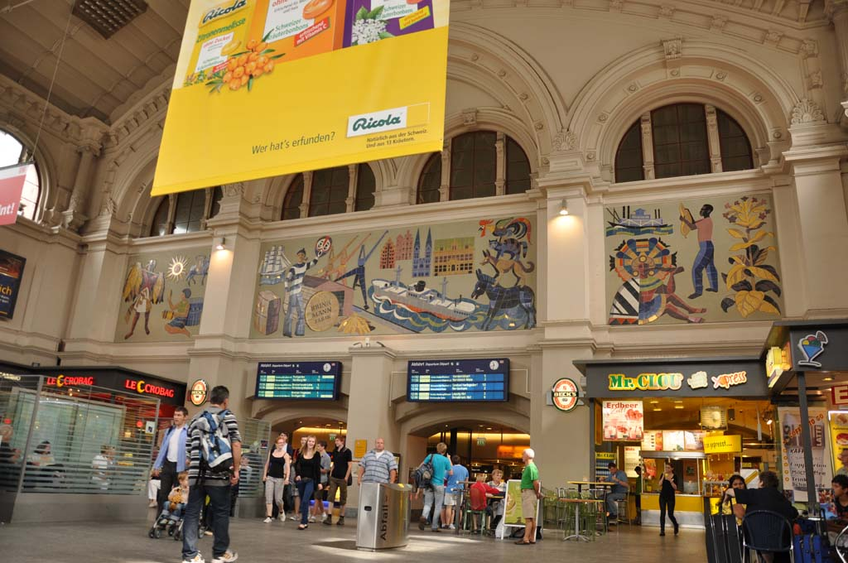

Slide 66
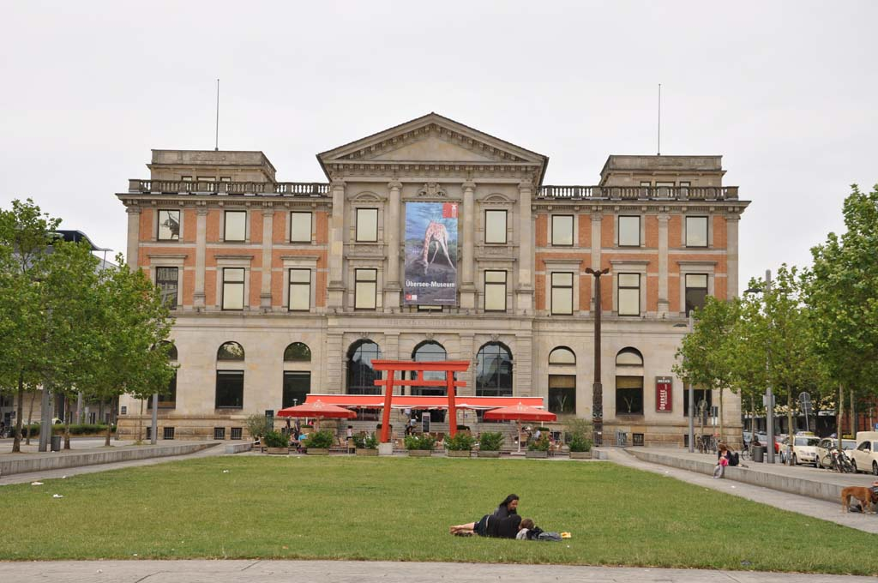

Slide 68
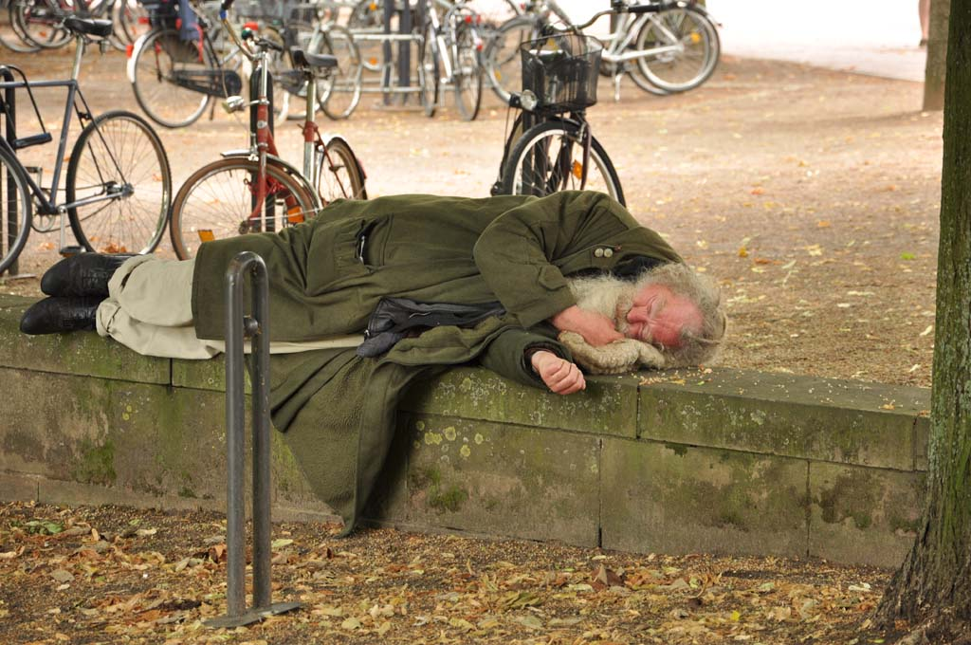

Slide 69
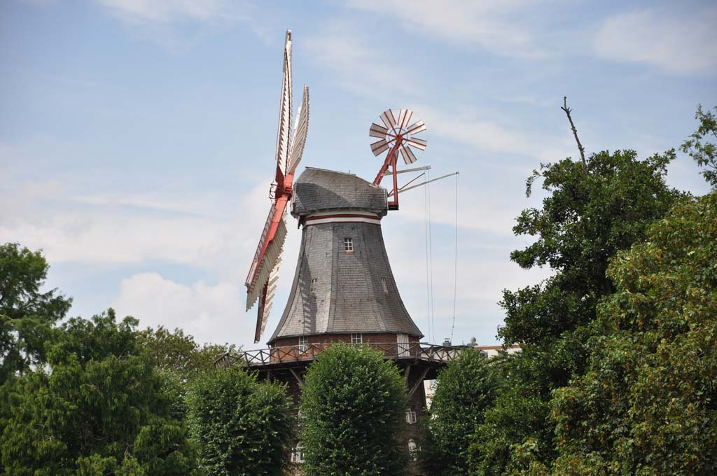

Slide 74
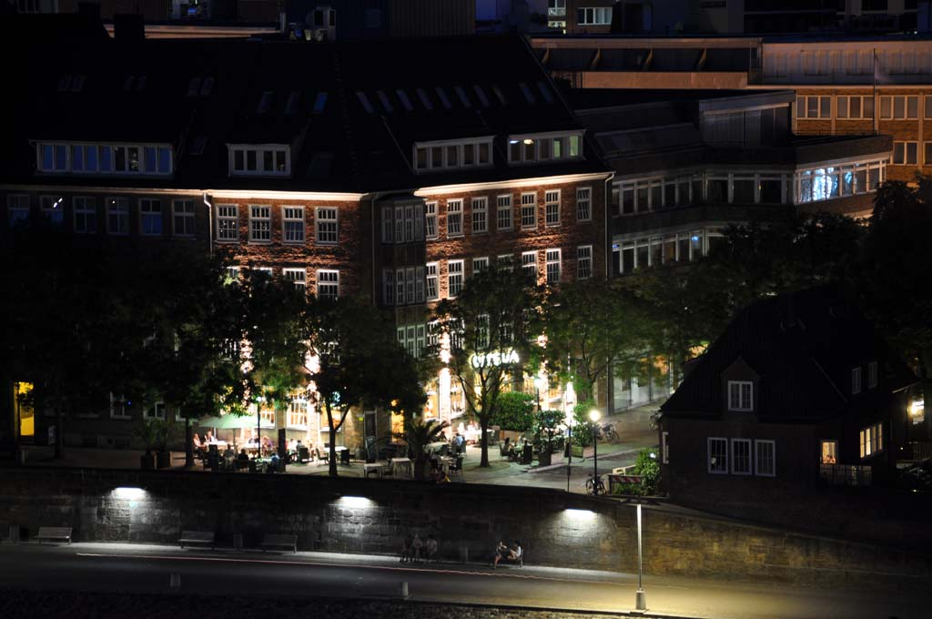

Slide 79
A Comparative Study
Danke, und Auf Wiedersehen!
Victor Hernandez, Ph.D.
&
Daniel Cox

